Slide 1

Credit card fraud detection
DS4-Fall 2023
Hooman Hashemi

Slide 2
Problem Statement
Develop a robust fraud detection and monitoring system to address the escalating issue of financial fraud in the US, where consumers lost $8.8 billion in 2022. Focus on credit card fraud, a prevalent form causing over $180 million in annual losses, impacting 26% of US adults. Financial institutions aim to curb losses through significant investments in anti-fraud technologies, with analytics being a key focus. The challenge is to create a system that integrates data from various sources, including transactional details, customer behaviors, and machine learning outcomes, to provide actionable insights for mitigating fraud risks.

Slide 3
Steps
Data Exploration
exploratory data analysis to identify insights and patterns
Understand the dataset and its features to assess data quality
Conduct feature engineering to select relevant features for the model
Building Models
Build a predictive model capable of predicting the probability that a transaction is fraudulent
Compare models
Compare Accuracy and confusion matrix to choose the best model

Slide 4
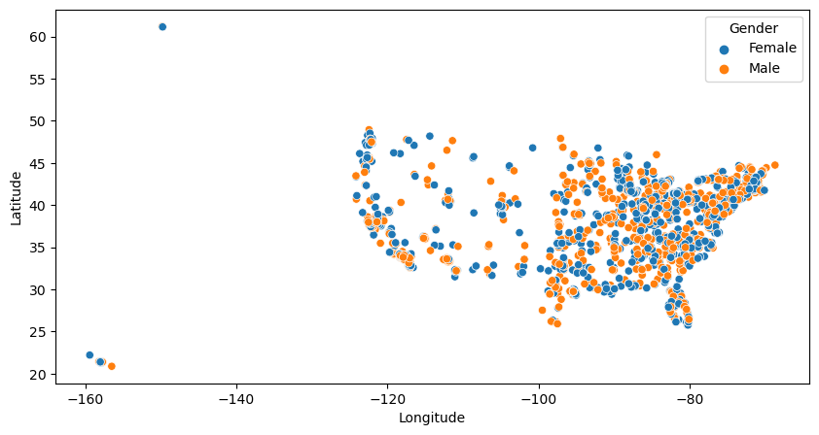
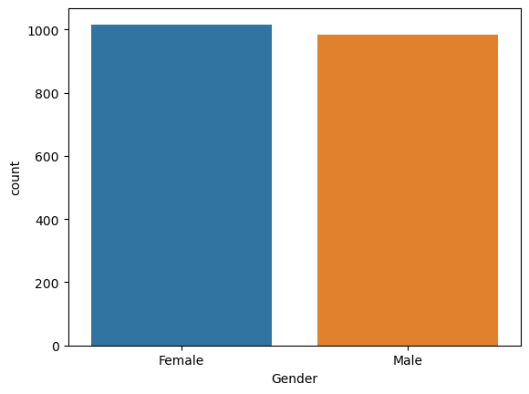
Data Exploration
User dataset: How the data is distributed based on the gender of the customer

Slide 5
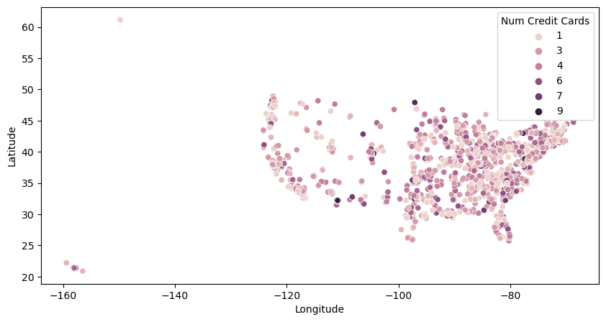
Data Exploration
User dataset: How many credit cards each user has?

Slide 6
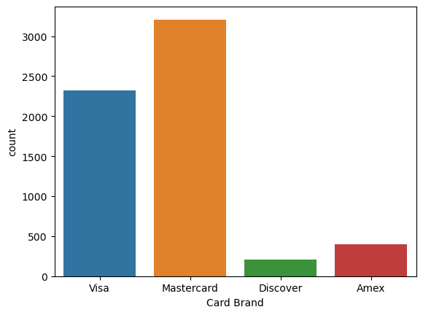
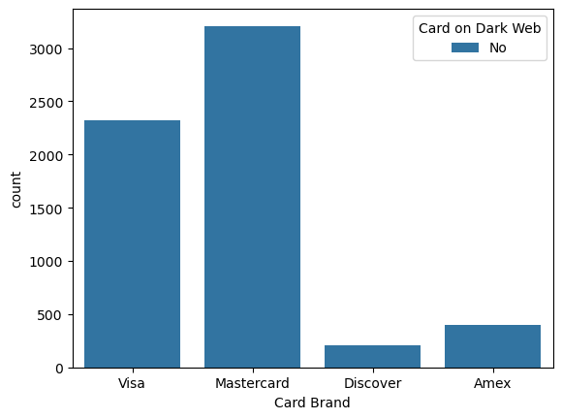
Data Exploration
Card dataset: What is the number of card in each category? Do they appear on dark web?

Slide 7
Data Exploration
Card dataset: What is the number of card in each category? Do they appear on dark web?
All answers are ‘No’, drop
the column!

Slide 8
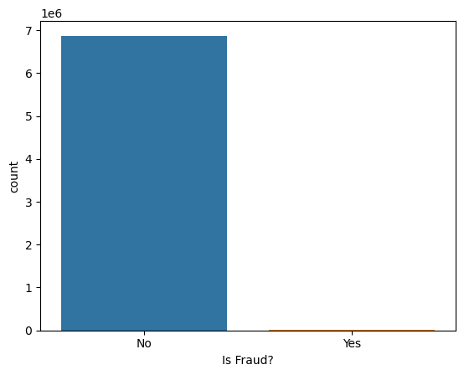
Data Exploration
Transaction dataset: Is the data balance?
No | Yes
6869425 | 8412

Slide 9
Handle Imbalance Data
Resampling Techniques:
Over-sampling (e.g., SMOTE)
Under-sampling
Algorithm-Level Techniques:
Cost-sensitive Learning
Ensemble Methods (e.g., boosting)
Under-sampling
Addressing imbalance enhances model performance and ensures fair representation of all classes.

Slide 10
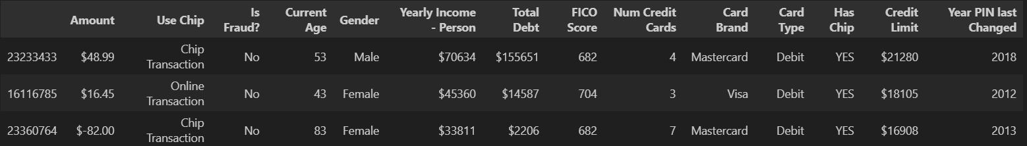
Final dataset that I chose:
I used SequentialFeatureSelection from sklearn to choose the top features in each dataset.
Then merge them to create a final dataset.
Under sampled the transaction dataset to have balanced data.

Slide 11
Predictive Models
Logistic Regression (base model)
Random Forest Classifier
Deep Neural Network

Slide 12
Split data train/test
Logistic Regression (base model)
Random Forest Classifier
Deep Neural Network
For all the models, I split the data in to two sets, train and test, where test were %30 of the entire dataset

Slide 13
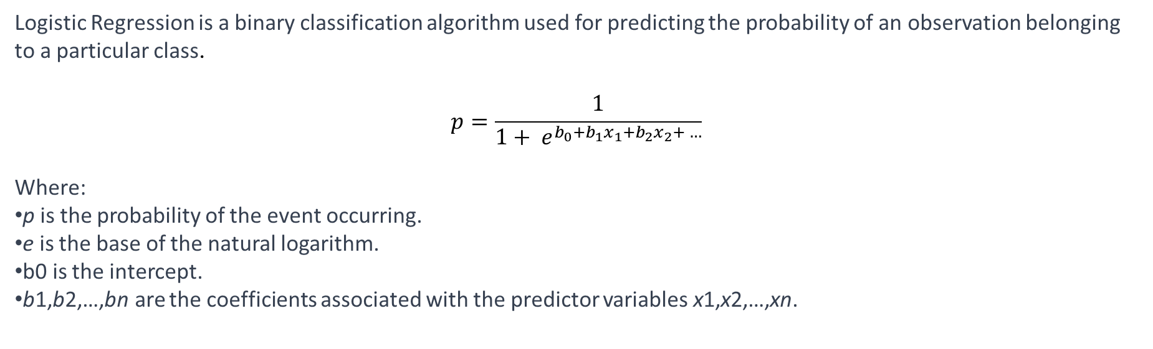
Logistic Regression
Logistic Regression is a binary classification algorithm used for predicting the probability of an observation belonging to a particular class.
$$p=\frac{1}{1+ e^{b_{0}+b_{1}x_{1}+b_{2}x_{2}+ …}}$$
Where:
p is the probability of the event occurring.
e is the base of the natural logarithm.
b0​ is the intercept.
b1,b2​,…,bn​ are the coefficients associated with the predictor variables x1​,x2​,…,xn​.

Slide 14
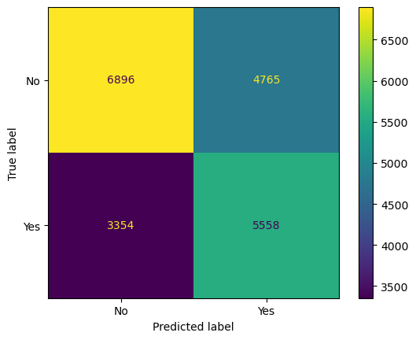
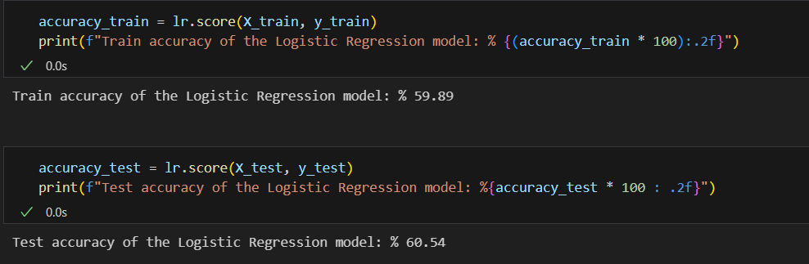
Logistic Regression

Slide 15
Random Forest
Random Forest is an ensemble learning method that constructs a multitude of decision trees during training and outputs the class that is the mode of the classes (classification) or mean prediction (regression) of the individual trees.
Aggregates predictions from multiple decision trees to improve overall accuracy and generalization.

Slide 16
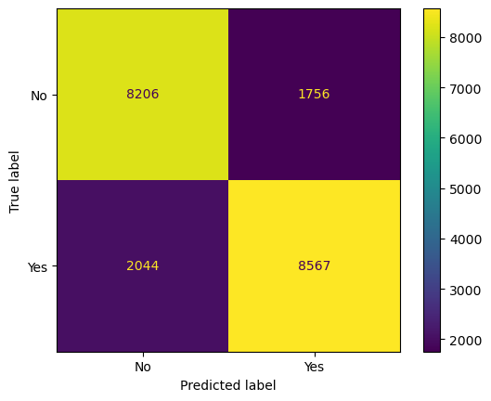
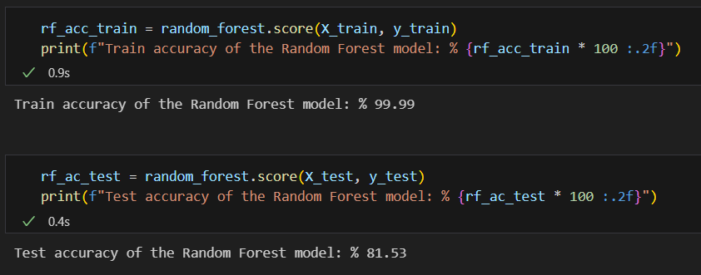
Random Forest

Slide 17
Deep nN-MLPClassifier
Multi-layer Perceptron classifier from sklearn.
One hidden layer with 100 neurons.
This model optimizes the log-loss function.
‘adam’ optimizer

Slide 18
Deep nN-MLPClassifier
Multi-layer Perceptron classifier from sklearn.
One hidden layer with 100 neurons.
This model optimizes the log-loss function.
‘adam’ optimizer.

Slide 19
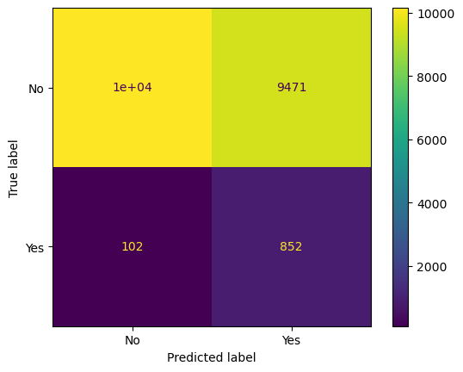
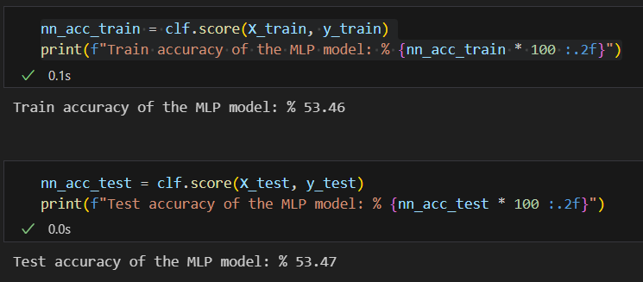
Deep nN-MLPClassifier

Slide 20
Conclusion
Logistic Regression:
Strengths:
Simple, interpretable.
Suitable for binary classification.
Limitations:
Assumes linearity, may struggle with non-linear relationships.
Random Forest:
Strengths:
Ensemble method, high accuracy.
Robust to outliers, handles complex relationships.
Limitations:
Less interpretable compared to individual decision trees.
MLPClassifier (Deep Neural Net):
Strengths:
Ability to model complex non-linear relationships.
Automatic feature learning.
Limitations:
Requires more data, sensitive to hyperparameters.
Best Model: Random Forest
Reasoning:
Achieved highest accuracy.
Robust performance, handled complex patterns well.
In our model comparison, the Random Forest outperformed Logistic Regression and MLPClassifier, demonstrating superior accuracy and robustness.

